Slide 1

SAP BTP ABAP on Cloud / RAP Training
DAY-10
Anubhav Oberoy
www.AnubhavTrainings.com
Follow excellence with sheer passion

Slide 2


DISCLAIMER
The training content and delivery of this presentation is confidential, and cannot be recorded, or copied and distributed to any third party, without the written consent of Anubhav Trainings

Slide 3

01
Value Helps
02
Status
03
Object Page
04
Facets and Table
Notes:
https://pixabay.com/photos/san-francisco-transamerica-pyramid-1633203/

Slide 4

Development Flow – Processor and Approver
Fiori App – Processor
Create, update, delete, copy travel
Fiori App – Approver
Display the travel request data
Service definition
Service Binding
Service definition
Service Binding
MDE for Processor Projection
MDE for approver Projection
BDEF Projection
For Processor
Expose what is needed by a processor role in company
Behavior Definition (BDEF)
Tell RAP framework regarding our operations which needs to be supported for BO (managed)
BDEF Projection
For Approver
Expose what is needed by a approver role in company
Business Object Projection
For Processor
30 fields to internet
Business Object (definition)
Includes the Travel, Booking and Booking Supplement CDS entities
100 fields
Business Object Projection
For Approver
25 fields
www.anubhavtrainings.com

Slide 5
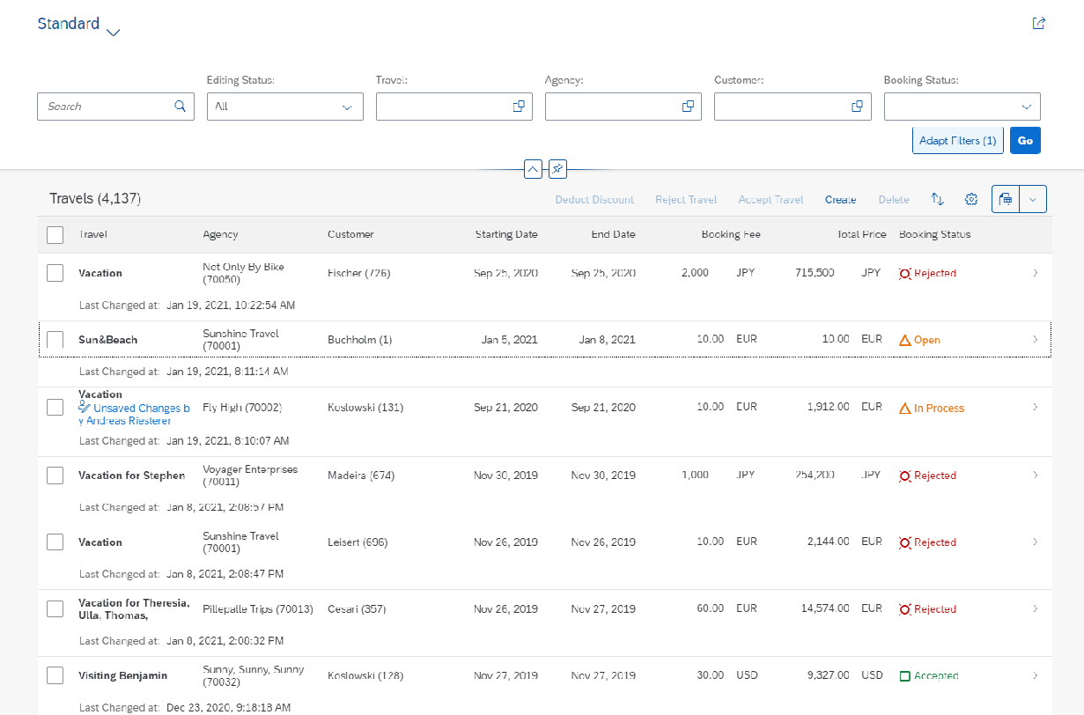
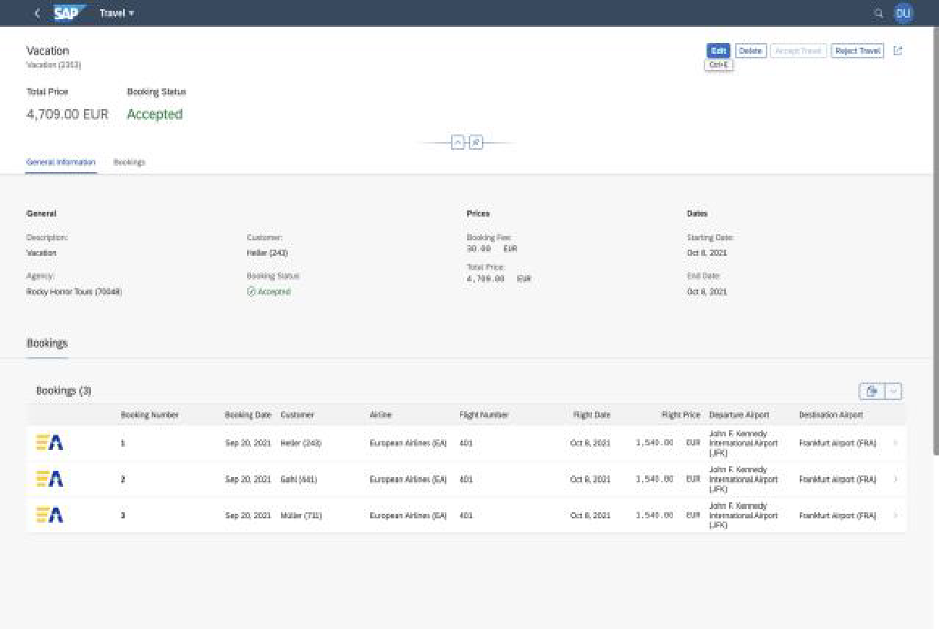
Fiori Elements - List Report Application
The list report offers powerful features for finding and acting on relevant data sets. It is often used as an entry point for navigating to the item details, which are usually shown on an object page.
List Report
Object Page
www.anubhavtrainings.com

Slide 6
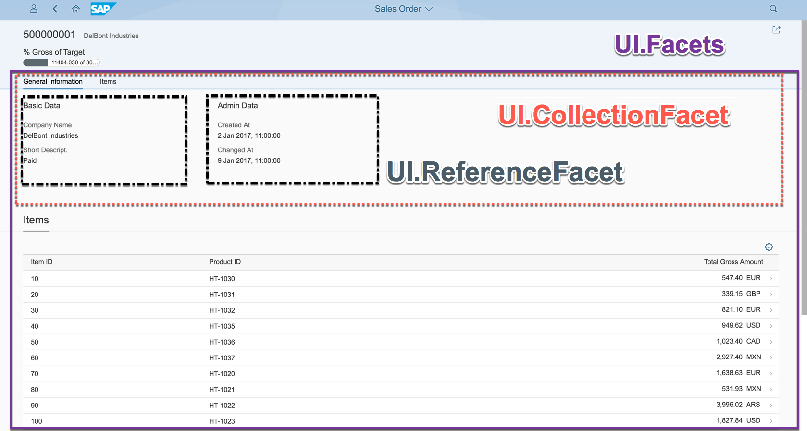
Object Page
www.anubhavtrainings.com

Slide 7












Slide 8
www.anubhavtrainings.com
Thank You
End of Day 10
www.anubhavtrainings.com

Slide 9


We’re committed to empower you to be
#FutureReady
through powerful training solutions.
We build the workforce of the future.
250+
Corporate Clients
30,000+
Learners Trained
25000+
Learners Placed
FREE WEBINARS
Sign up for free webinars with industry experts every fortnight!
Enroll Now!
Contact us today!
https://anubhavtrainings.com

